Slide 1







PROJECTS | PRODUCTS | COURSE | INTERNSHIP
info@discoverprojects.com
www.discoverprojects.com
pro.aiskool@gmail.com
www.aiskool.com
Shop no. 2, Narayan Smurti Building, Opp. Saraswati Book Depot,
Near CIDCO Bus Stop, Thane West, India.
+91 9967478289 / +91 9167769993

Slide 2

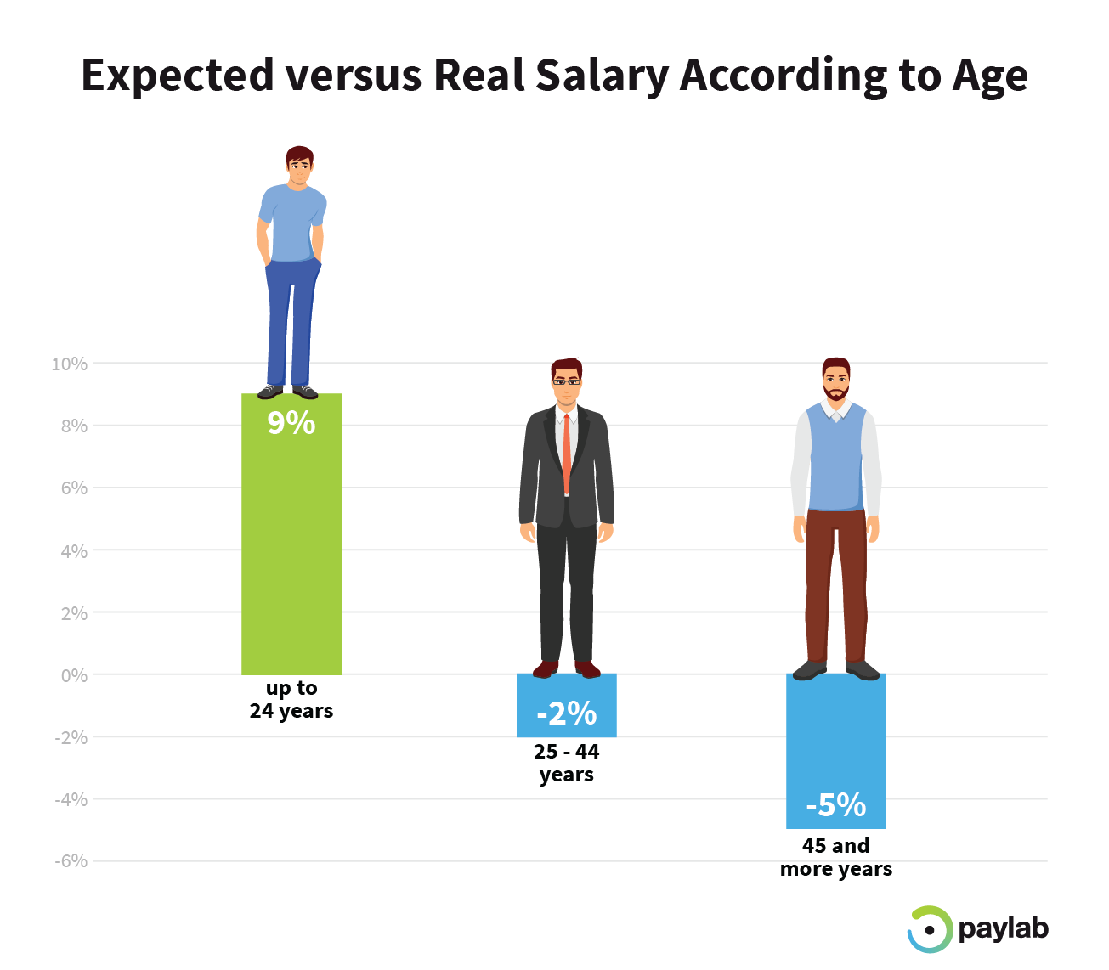
Salaries with respect to Position
Relevant Image

Slide 3
Introduction and Application
The objective is build a machine to predict estimated salary in respect to positions with the help of random forests (regression method).

Slide 4
Working
FIRST STEP WAS TO COLLECT DATA FROM DIFFERENT SOURCES FOR OUR PROBLEM STATEMENT .
THEN WE HAVE TO CLEAN , PROCESS CATEGORICAL DATA AND NORMALISE IT.
THEN WE SHOW VARIOUS ANALYSIS USING GRAPHS.
SPLIT THE DATA INTO TRAINING AND TEST SET.
SELECT AN ALGORITHM.
FITTING THE MODEL TO TRAINING SET.
SAVING THE MODEL
CHECK ACCURACY OF TRAINED DATA W.R.T TRAIN SET.
TEST THE TRAINED MODEL W.R.T TESTING SET.
CHECK ACCURACY OF TEST DATA W.R.T TEST SET.
BASED ON THE GENERATED GRAPHS WE PREDICT THE SALARIES WITH RESPECT TO POSITIONS.

Slide 5
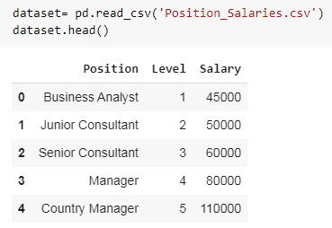
Working and Building
This is the data that we are using for the estimation of salary with respect to position. The source of dataset is Kaggle.

Slide 6
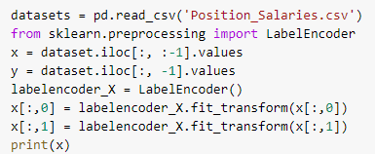
Handling Categorical Data
Label encoding is simply converting each value in a column to a number.

Slide 7

Normalise Data
StandardScaler transforms features by scaling each feature to a given range.
fit(self, X[, y]):
Compute the minimum and maximum to be used for later scaling.
transform(self, X):
Scale features of X according to feature_range.

Slide 8
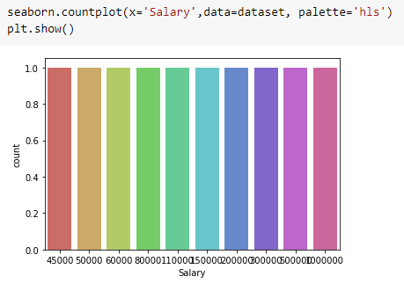
Graphs
countplot. Show the counts of observations in each categorical bin using bars. A count plot can be thought of as a histogram across a categorical.

Slide 9
Splitting Data
Python has a library sklearn which contains a function ‘train_test_split’. This function is used to Split arrays or matrices into random train and test subsets.
test_size float or int, default=None:
If float, should be between 0.0 and 1.0 and represent the proportion of the dataset to include in the test split. If int, represents the absolute number of test samples. If None, the value is set to the complement of the train size. If train_size is also None, it will be set to 0.25.
random_state int or RandomState instance, default=None
Controls the shuffling applied to the data before applying the split. Pass an int for reproducible output across multiple function calls.

Slide 10

Selecting Algorithm
Random forests or random decision forests are an ensemble learning method for classification, regression and other tasks that operate by constructing a multitude of decision trees at training time and outputting the class that is the mode of the classes or mean prediction of the individual trees.

Slide 11
Fitting the model to trained dataset
We have used the fit() function to fit our model to the training dataset and hence passed the parameters for the same.

Slide 12
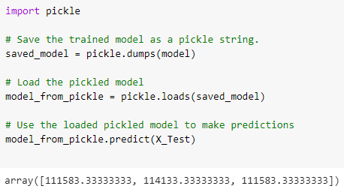
Saving the model
We can use the Pickle library in Python to save our model. In this code we can see that the model has been saved as a string.
So, first we save the model as a string, then we load it and use it to make predictions.

Slide 13
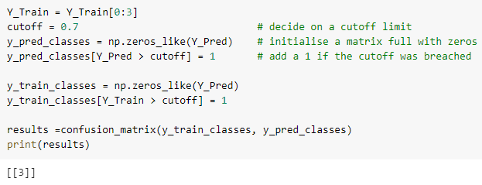
Confusion Matrix
Confusion Matrix function is present in the sklearn library of Python. A confusion matrix is a table that is often used to describe the performance of a classification model (or “classifier”) on a set of test data for which the true values are known. It allows the visualization of the performance of an algorithm.
In this code we have used a cut-off. This is because we have converted all the values in the dataset into binary by using the zeroes_like() function so that no error because of continuous data occurs.

Slide 14
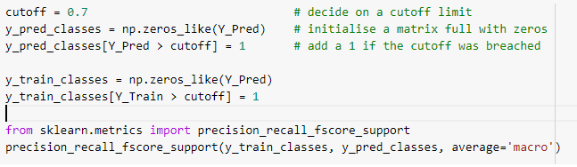
Precision, Recall, Support, Fscore
The precision is intuitively the ability of the classifier not to label as positive a sample that is negative. The recall is intuitively the ability of the classifier to find all the positive samples.The F-beta score can be interpreted as a weighted harmonic mean of the precision and recall, where an F-beta score reaches its best value at 1 and worst score at 0.The support is the number of occurrences of each class in y_true. We have used the precision_recall_fscore_support() function for the same. And, again we have used the cut-off values for converting the array into binary.
**In the same way we will calculate the confusion matrix, precision, recall, support and fscore for the test dataset.**

Slide 15
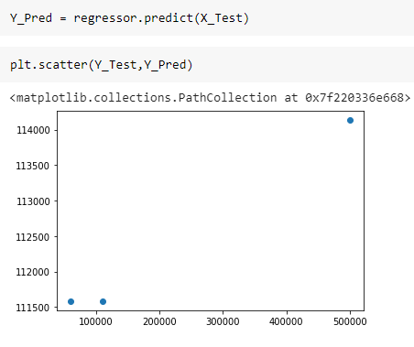
Prediction
We have used the predict() function for making the predictions on our model. Also, scatter() method is used to plot the graph for our predictions.

Slide 16
Evaluate, Tune and Improve Neural Network
In this code we have used the MSE, MAE and RMSE method for evaluation.
Mean Absolute Error: We know that an error basically is the absolute difference between the actual or true values and the values that are predicted.
Mean Square Error: MSE is calculated by taking the average of the square of the difference between the original and predicted values of the data.
Root Mean Square Error: RMSE is the standard deviation of the errors which occur when a prediction is made on a dataset. This is the same as MSE (Mean Squared Error) but the root of the value is considered while determining the accuracy of the model.

Slide 17
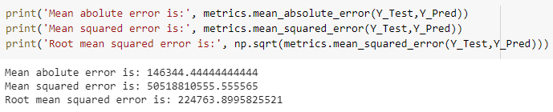
Calculating Efficiency:
We have used the mean_absolute_error(), mean_squared_error() and square root of mean_squared_error() functions of metrics from sklearn library of Python to calculate the MAE, MSE and RMSE values.

Slide 18

Accuracy:
Accuracy is the most intuitive performance measure and it is simply a ratio of correctly predicted observation to the total observations. One may think that, if we have high accuracy then our model is best. Yes, accuracy is a great measure but only when you have symmetric datasets where values of false positive and false negatives are almost same. Therefore, you have to look at other parameters to evaluate the performance of your model.
Accuracy = TP+TN/TP+FP+FN+TN

Slide 19
FAQ
When is Random Forest used?
Random forest algorithm can be used for both classifications and regression task. It provides higher accuracy. Random forest classifier will handle the missing values and maintain the accuracy of a large proportion of data. If there are more trees, it won't allow overfitting trees in the model.
What makes Random Forest unique?
Random forest improves on bagging because it decorrelates the trees with the introduction of splitting on a random subset of features. This means that at each split of the tree, the model considers only a small subset of features rather than all of the features of the model.

Slide 20
FAQ
3. How does Random Forest work for Regression?
Sample multiple subsamples with replacement from the training data
Train a decision tree for regression (splitting e.g. by maximizing reduction in variance ) on each subsample, where each leaf node outputs the mean of all label values in the node.
Predict by averaging over the predictions of all decision trees.

